Slide 1
CS 470 Project Two Conference Presentation: Cloud Development
Briana Long
August 2025

Slide 2
Overview
Briana Long, Computer Science major at SNHU.
Serverless integration into AWS matters
How to use it to scale startups
Preview the tools and principles used
Notes:
Hello! My name is Briana Long. I am a senior Computer Science major at SNHU.
This presentation is to highlight migrating a full stack application into an Amazon Web services. This is a serverless, cloud based environment. This pivot allows for a cost effective scalability. While also integrating security and automation.

Slide 3
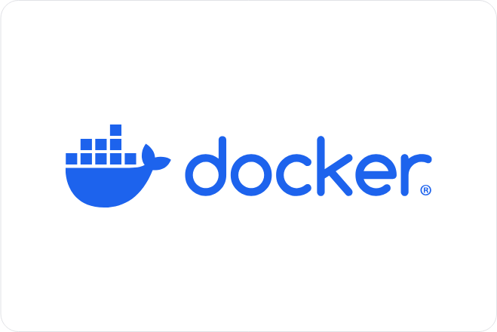
Containerization
Models: Monolithic to Microservices
Tools: Docker
Why containerization helps: Portability and Consistency
Notes:
Monolithic architecture is a software design where all components of an application are integrated and deployed as a single unit.
Compared to using Docker, which is a microservice that breaks down components into smaller services.
It is used as a container for consistent environments across machines.

Slide 4
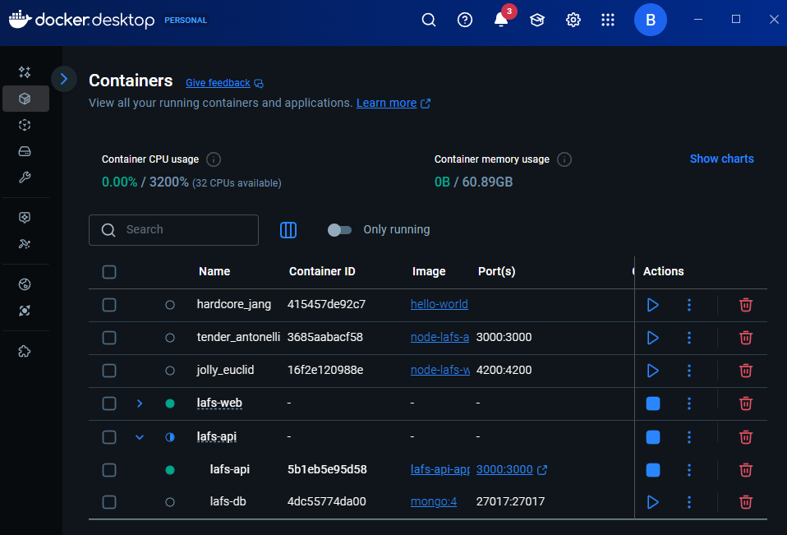
Orchestration
Orchestration: automation and management of tasks
The value of docker compose is a multi-container management
Notes:
Orchestration is the automation and management of complex tasks and workflows across systems and services.
It creates a central point of control to the streamline process and reduce manual intervention.
Docker Compose runs multiple containers in sync. This includes frontend, backend, and a database. This reduces setup errors that can occur.

Slide 5
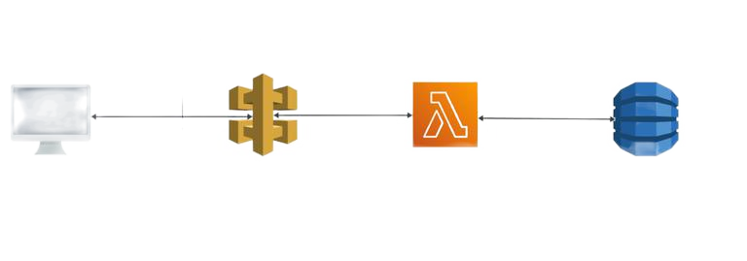
The Serverless Cloud
Serverless
Rather than no servers, AWS manages the servers.
S3 storage is cloud based where data is stored in buckets.
This allows for retrieval on any machine or environment used.
Notes:
Rather than no servers, AWS manages the servers.
S3 storage is cloud based storage service provided by Amazon Web Services.
Data, known as objects, is stored in buckets rather than locally. This makes the data more accessible compared to local storage on one machine.
The key features of using a serverless cloud are scalability, availability, security and cost effectiveness.
This makes it the perfect solution for startups that want to scale up.

Slide 6
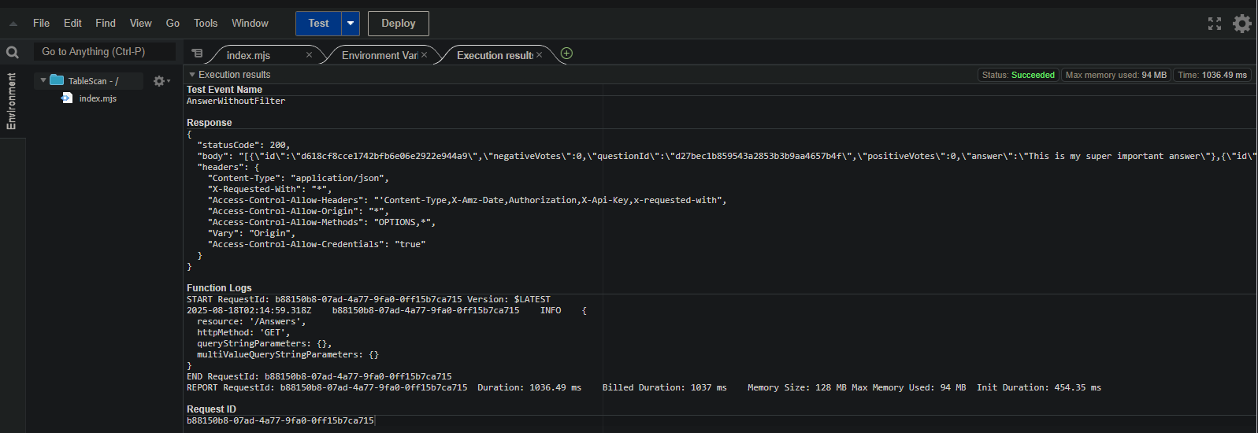
The Serverless Cloud
API & Lambda
Features scalability, availability, security, and is cost effective.
API gateway routes clients requests to the Lambda functions without servers.
Scripts needed to run the Lambda are written to handle business logic.
The Frontend connects via API endpoints to the backend services.
Notes:
The serverless API is used to route requests from the frontend to the Lambda functions.
The code running only when there are requests allows for a cost effective server.
The front end is exposed through REST endpoints that use the API Gateway.
The front end makes HTTP requests while Lambda executes backend logic and response.
The Lambda function contains the backend logic. A script is made and ran in Node.js.
It connects to the DynamoDB and returns a JSON response.

Slide 7
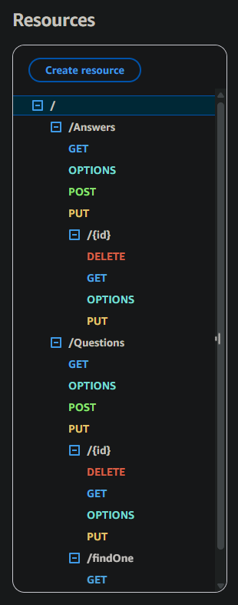
The Serverless Cloud
Database
MongoDB uses flexible JSON documents, queries and secondary indexes
DynamoDB uses key-value and documents, PK/SK schema, access pattern driven and GSIs
Queries used were GET, OPTIONS, POST, PUT, and DELETE.
Scripts were produced and used in queries that produced a JSON item.
Notes:
MongoDB uses flexible JSON documents, queries and secondary indexes
DynamoDB uses key-value and documents, PK/SK schema, access pattern driven and GSIs
Queries used were GET, OPTIONS, POST, PUT, and DELETE.
Scripts were produced and used in queries that produced a JSON item.
Using DynamoDB is a serverless flexible access patterned model compared to a documented one.
Every item has a partition key and sort key in tables.

Slide 8
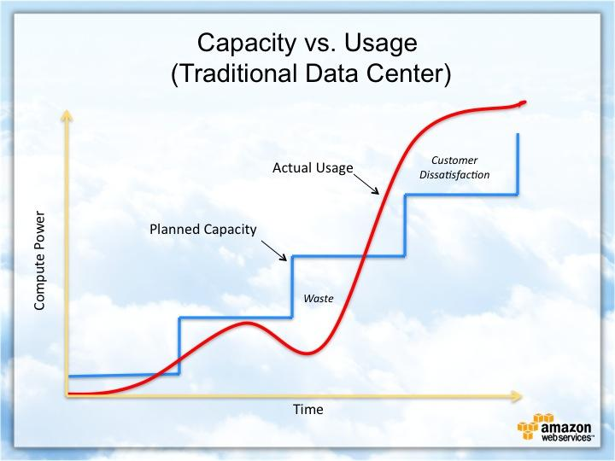
Cloud-Based Development Principles
Elasticity of services that scale with traffic and prevents idle servers
Pay-for-use model is billed per request, storage or reads
Equals faster features, lower overhead costs and predictable costs and scale and user increases occur.
Notes:
Elasticity of services that scale with traffic and prevents idle servers.
This is important when using a serverless design that scale automatically.
Pay-for-use model is billed per request, storage or reads. This allows for accurate costs that align with usage.
Equals faster features, lower overhead costs and predictable costs and scale and user increases occur.
The graph illustrates that traditional setups waste money and hurts customers compared to a cheaper serverless setup.

Slide 9
Securing Your Cloud App
Access
AuthN/AuthZ: Amazon Cognito (JWTs), optional Lambda Authorizer for custom logic
Transport: HTTPS only (ACM certs, custom domain), enforce TLS 1.2+
Edge protection: AWS WAF on API Gateway; throttle/quotas & usage plans
Validation: API Gateway request validation (JSON Schema) + input checks in Lambda
Data protection: KMS-backed encryption (DynamoDB, S3)
Notes:
For access control, we authenticate users with Cognito, which issues JWTs the API validates either natively or through a Lambda Authorizer.
All traffic uses HTTPS with an ACM certificate and a custom domain.
We put AWS WAF in front of API Gateway for IP allow/deny and common attack protection, and we enabled throttling and usage plans to limit abuse.
API Gateway also validates request bodies against JSON Schema before requests ever reach Lambda.
Data at rest is encrypted with KMS, and application secrets live in Secrets Manager/Parameter Store.

Slide 10
Securing Your Cloud App
Policies
Roles are identities assigned to users.
Policies are granted the least-privilege actions on resources.
Labrole was given the access to all of the AWS to prevent overreaching permissions and access.
Notes:
For policies, we followed least-privilege.
A Lambda execution role gets only the DynamoDB actions it needs on our table and GSIs, scoped to ARNs.
Another policy limits S3 access to a specific bucket prefix, and we grant the minimal KMS permissions required.
API Gateway has permission to write logs.

Slide 11
Securing Your Cloud App
API Security
API Gateway ↔ Lambda: Cognito or Lambda Authorizer (validate JWT scopes/claims), request throttling, strict CORS
Lambda ↔ DB: IAM role only; validate inputs; parameterized expressions; optional VPC endpoints for private access patterns
S3: Block Public Access, pre-signed URLs for uploads/downloads, SSE-KMS, versioning + lifecycle rules
Notes:
Gateway/Lambda path verifies JWTs and enforces CORS.
The Lambda-to-DynamoDB path uses IAM—no embedded credentials.
For S3, we block public access and use pre-signed URLs so clients never get blanket bucket permissions.
This combination prevents unauthorized access.

Slide 12
CONCLUSION
Serverless is the best choice for startups.
Data and integration allows LAMBDA to answer core queries.
Security is a feature by default. This prevents unauthorized users, least privilege policies in place along side encryption and end to end HTTPS.
Thank you for your time.
Notes:
Serverless is the best choice for startups. It is a cost effective solution compared to containers.
Data and integration allows LAMBDA to answer core queries. An access pattern is used to increase infrastructure.
Security is a feature by default. This prevents unauthorized users, least privilege policies in place along side encryption and end to end HTTPS.

